Slide 1
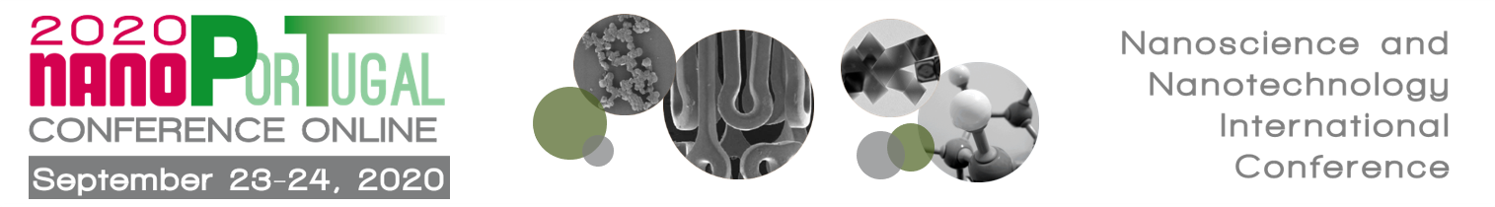







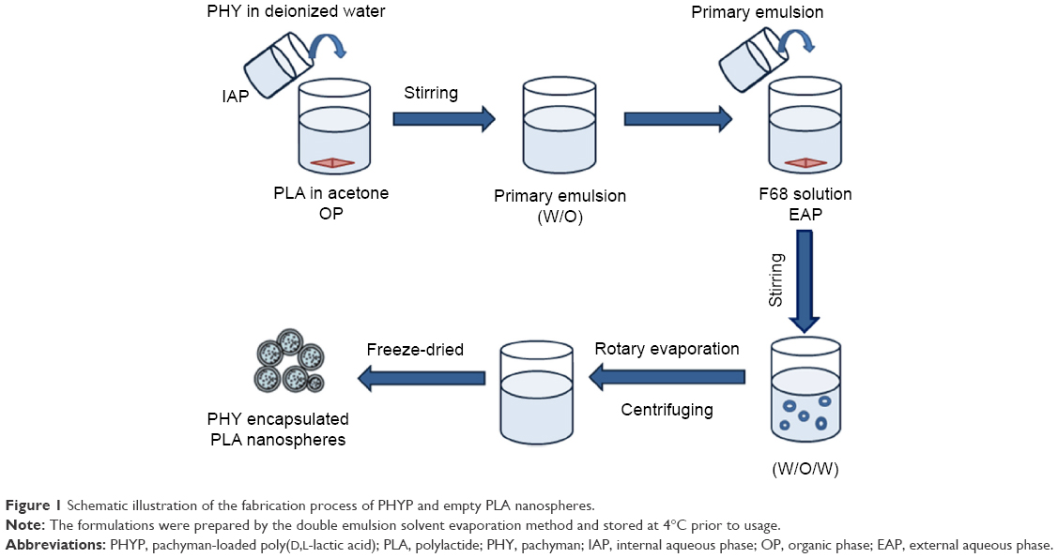
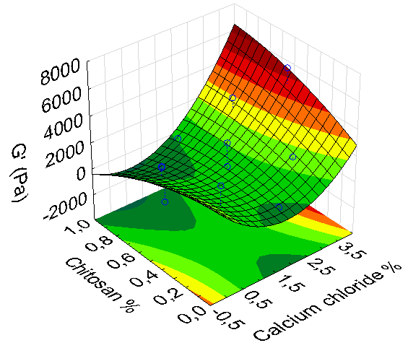
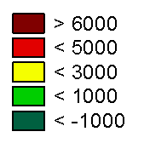
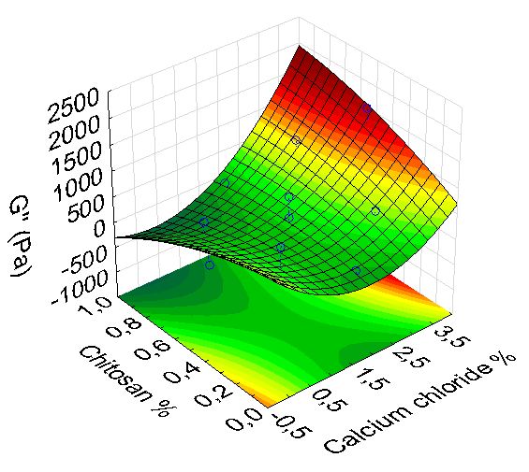
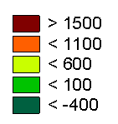
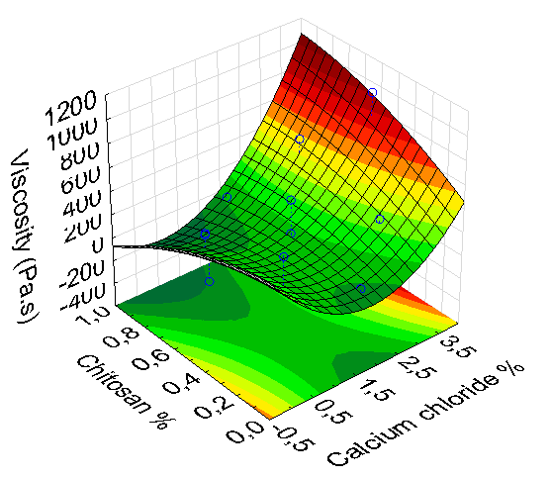
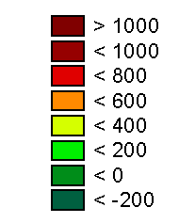


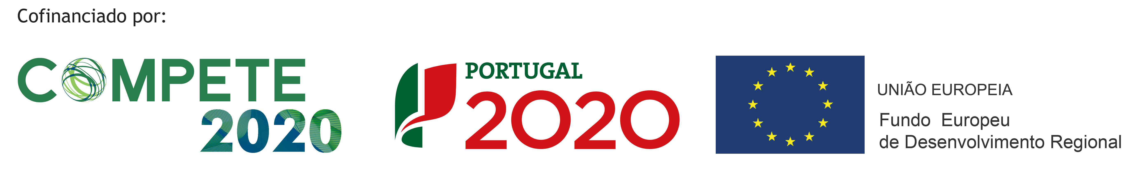
QbD optimization of hydrogels loading PLGA nanoparticles for wound healing
Ana S. Macedo¹, Inês Duarte², Salette Reis¹, Pedro Fonte^{1,2,3,4}
^{*1}LAQV, REQUIMTE, Department of Chemical Sciences - Applied Chemistry Lab, Faculty of Pharmacy, University of Porto, Rua de Jorge Viterbo Ferreira, 228, 4050-313 Porto, Portugal
²iBB-Institute for Bioengineering and Biosciences, Department of Bioengineering, Instituto Superior Técnico, Universidade de Lisboa, 1049-001 Lisboa,
³Center for Marine Sciences (CCMAR), University of Algarve, Gambelas Campus, 8005-139 Faro, Portugal,
⁴Department of Chemistry and Pharmacy, Faculty of Sciences and Technology, University of Algarve, Gambelas Campus, 8005-139 Faro, Portugal
INTRODUCTION
The skin is the main barrier in the body whose function is to protect it from infection and dehydration. When the barrier is damaged, a wound is formed, and the healing process begins. Acute wounds heal in 12 weeks, whereas chronic wounds need months [1]. Hydrogels are hydrophilic molecular networks produced by the physical or chemical cross-linking of polymers and have been used for wound dressings [2]. The hydrogel potential in wound healing can be further explored with the loading of nanoparticles that allow controlled or sustained release of drugs. In this work, we propose the development of alginate hydrogels loaded with poly (lactic-co-glycolic acid) (PLGA) nanoparticles prepared by cross-linking with calcium. The optimisation of the hydrogel was carried out by Quality by Design using a Design of Experiments approach for the delivery of growth factors to accelerate wound healing.
METHODS
Nanoparticles were produced by a water-in-oil-in-water double emulsion technique [3]. A Central Composite Design was used to define the sample size and formulation composition. A total of 4 factors were studied; sodium alginate, glycerine, calcium chloride, and chitosan concentrations. 16 formulations were generated with 3 central points. The particle size and polydispersity index (PdI) were assessed by Dynamic Light Scattering (DLS) prior gelification and rheology was assessed with a rheometer (Rheometrics, TA Instruments, USA).
Drug solution
Sonication 30 seconds
W/O emulsion
Magnetic Stirring
Sonication 30 seconds
Dichloromethane + PLGA
W/O emulsion
2% PVA
W/O/W emulsion
PLGA nanoparticles
Figure 1 – Schematic diagram of the protocol used to produce PLGA nanoparticles.
RESULTS AND DISCUSSION
A
A
A
A
B
B
p=0.05
B
B
C
C
p=0.05
C
Figure 2 - (A) Nanoparticles size (nm) and polidispersity index (PdI) and (B) zeta potential values (mV) for nanoparticles without coating and coated with chitosan in a concentration range between 0,08%-0,92%.
Figure 3 - Surface response plots for the moduli (A) G’ (Pa) and (B) G’’ (Pa), and (B) viscosity (Pa.s) for the formulations tested. The effect of chitosan and calcium chloride concentrations are represented.
p=0.05
Figure 5 – Observed values vs Predicted values for the moduli (A) G’, (B) G’’, and (C) viscosity.
Figure 4 - Pareto plots to determine the effect of each component and interaction between components for the moduli (A) G’ (Pa) and (B) G’’ (Pa), and (C) viscosity (Pa.s). Statistically significance was set at p=0.05, as represented in the plots.
An increase in particle size and PdI were observed with the increase in chitosan concentrations, suggesting that the nanoparticles were efficiently coated (Fig. 2A). Furthermore, a shift in the zeta potential was also observed from -20 mV to 25 mV, confirming the coating with chitosan (Fig. 1B). High zeta potential values and low PdI values contribute to higher staibility against aggregation and mitigate the Ostwald ripening effect. The surface response plots show the interaction between the chitosan and calcium chloride for the moduli G’, G’’, and viscosity (Fig. 2) and the pareto charts of the components (Fig. 3) show that calcium chloride and the interaction between calcium chloride and chitosan are the most relevant factors for the rheology properties of the hydrogels. Viscosity and G’’ were significantly affected by the concentration of calcium chloride (p=0,05). The model was tested to determine the suitability of the model to predict the formulation behaviour (Fig 4). A correlation value of 0.85 was found between the predicted values and the observed results, showing the adequacy of the model to predict the formulation behaviour.
CONCLUSION
ACKNOWLEDGEMENTS
The Central Composite Design allowed to understand the influence the formulation parameters on the overall characteristics of the PLGA-nanoparticles loaded hydrogel. The formulation rheology was dependent on the calcium chloride concentration, although chitosan also contributed to the overall characteristics. The formulations will be further used to deliver growth factors and its in vitro and in vivo performance will be evaluated.
The authors thank to Prof António Diogo for the invaluable input in the rheology studies. This work was financed by FEDER - Fundo Europeu de Desenvolvimento Regional funds through the COMPETE 2020 - Operational Programme for Competitiveness and Internationalization (POCI), and by FCT - Fundação para a Ciência e a Tecnologia (FCT) in the framework of the project POCI-01-0145-FEDER-032610 - PTDC/MEC-DER/32610/2017. It also received Portuguese national funds from FCT - Foundation for Science and Technology through projects UIDB/50006/2020, UIDB/04326/2020 and UIDB/04565/2020.
Pedro Fonte prfonte@ualg.pt
REFERENCES
[1] Tejiram S et al., Curr Opin Crit Care. 25, 6, (2019) 647-652
[2] Grolman JM et al., J Burn Care Res. 40, 6, (2019) 900-906
[3] P. Fonte et al., Methods Mol. Biol., (2018) 255-274

