Slide 1

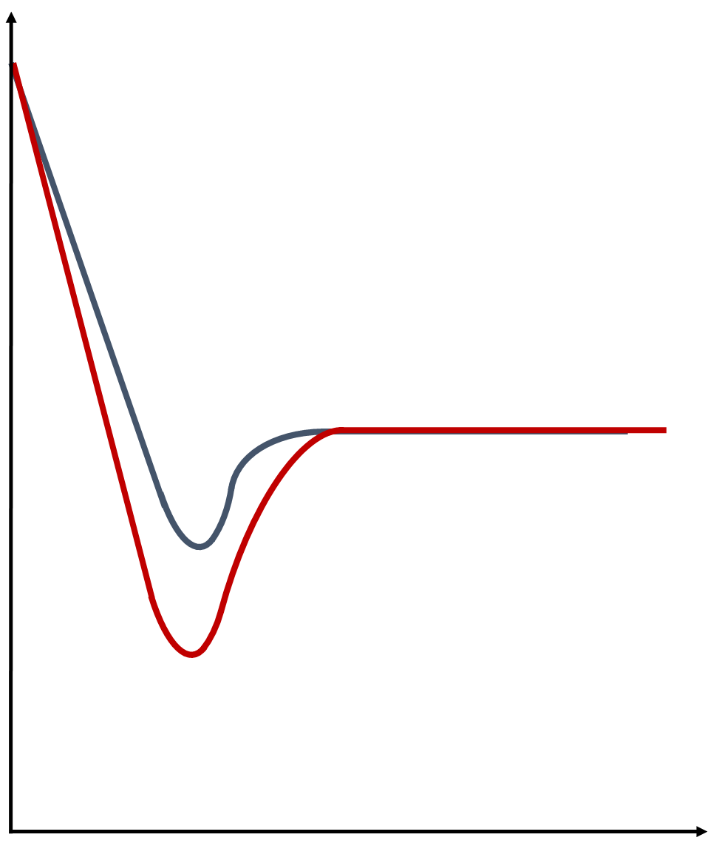

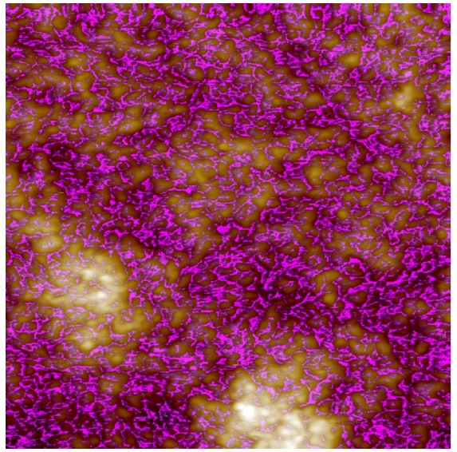
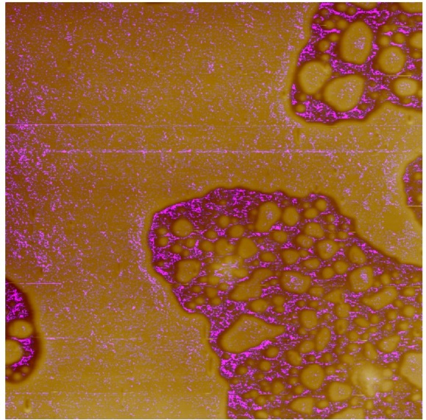
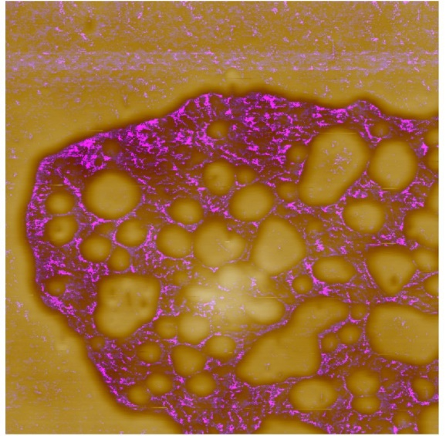
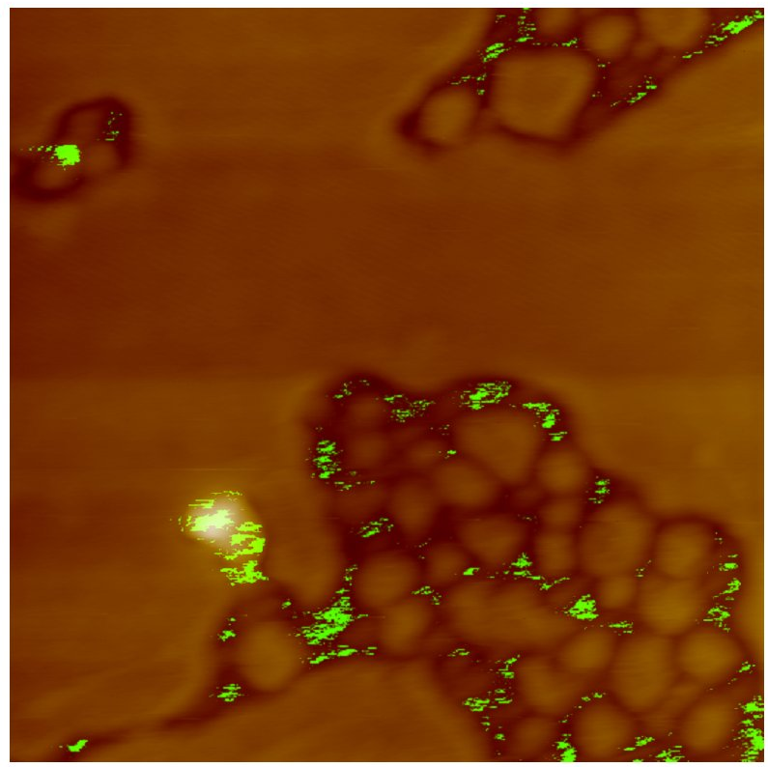

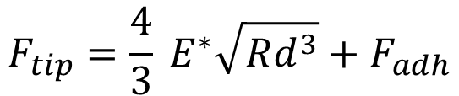

Surface modification and characterization of conductive nanostructured PEDOT:PSS thin films
Matteo Sanviti¹ Angel Alegria^{1,2}, Daniel E. Martinez-Tong^{1,2}
¹Centro de Física de Materiales, P. Manuel Lardizabal, 5, 20018, Donostia-San Sebastian, Spain
²Departamento de Física de Polimeros y Materiales Avanzados: Fisica, Quimica y Tecnologia, Universidad del País Vasco, P. Manuel Lardizabal, 3, 20018, Donostia-San Sebastian, Spain
Abstract
Poly(3,4-ethylenedioxythiophene): poly(styrenesulfonate) (PEDOT:PSS) has emerged to be one the most promising flexible electrode materials over rigid metallic oxides. This conducting polymer finds applications in many electric devices, such as OSCs, nanotransistors, supercapacitors, OLED, LCD, and wearable electronics [1]. In the past few years, many studies have been focused on the improvement and tuning of PEDOT:PSS electric and mechanical properties, by acting on its composition and/or surface structure[2]. In our present work, we investigated the formation of surface nanostructures on PEDOT:PSS thin films surfaces, after treatment with a low boiling point solvent. The thin films were obtained by spin coating polymer solutions on ITO substrates. Afterward, the obtained samples were treated by solvent vapor annealing. We studied the solvent treated PEDOT:PSS thin films by AFM techniques. AFM was used not only to evaluate the surface structures, but also to obtain mechanical and electrical properties. We observed that different PEDOT:PSS nanostructures were formed depending on the treatment time in the solvent vapor annealing chamber, with distinct physico-chemical properties.
Force Curve
AFM
Atomic Force Microscopy is a high resolution imaging technique based on the interaction between a probe, consisting of a sharp tip anchored on the cantilever, and the sample; the probe continuously scans the surface of the sample providing topological images and other surficial properties.
In Peak Force tapping the probe periodically interacts with the sample as shown in the figure below. By a real-time analysis of the obtained force-distance curves at each point, the system maps simultaneously many surface properties, such as elastic modulus, adhesion force and deformation. Here is shown an example of a characteristic force curve.
PEDOT:PSS
Approach
PEDOT:PSS is a conjugated polymer based on PEDOT coupled with PSS. PEDOT has relatively high conductivity and good transparency in its doped oxidized form, but it is insoluble in water. PSS is the charge balancer for the PEDOT oxidized chains in the PEDOT:PSS system. Since PSS is a water soluble material, it facilitates the dispersion of PEDOT in water and enables a stabilized PEDOT configuration by coulombic attractions through an ionic bond between PSS molecules and the ordered PEDOT molecules. PEDOT:PSS remains insoluble in water and it is commercially available as aqueous dispersion, which allows to easily prepare films of the conductive polymer. As shown in the figure, the obtained films are composed of conductive PEDOT:PSS rich grains with a shell of PSS. A fraction of PSS in excess (not coordinated to the PEDOT macromolecules) is always present in the commercial aqueous solution of PEDOT:PSS; then, a thin film obtained from this solution will present also PSS rich areas randomly distributed alongside the PEDOT:PSS particles[3,4].
Force
Withdrawal
PSS
3
1
2
4
$$F_{tip}=\frac{4}{3} E^{∗}\sqrt{Rd^{3}}+F_{adh}$$
PEDOT
$$F_{adh}$$
Shell - l ≈ 5-10 nm
d
Tip-sample separation
H2O
Core - r ≈ 25 nm
Comercial dispersion in water
Spin coating
SUBSTRATE
1.
2.
3.
4.
Solvent Vapor Annealing treated thin films
Nanomechanical AFM
Films specifics:
The PEDOT:PSS thin films were prepared by spin coating a commercial solution (3-4% of PEDOT:PSS (w/w) in H2O) over ITO glass substrate at 3 krpm for 120 seconds.
The thickness of the films was 430 nm, as estimated by AFM height images on a step between the film and the ITO surface.
The so obtained films were treated by Solvent Vapor Annealing in a THF saturated atmosphere at different times.
By the investigation of the mechanical properties at the surface we were able to provide information on the surface nanostructure nature. As we can see in the example below, a sample of PEDOT:PSS thin film treated with THF for 10 minutes showed two phases at the surface, one of them preserves the mechanical properties of pristine PEDOT:PSS, the other one has a lower roughness and modulus.
Magenta pixels in the image refer to regions on the sample where was registered a Young’s modulus greater than ~2,7 GPa.
PEDOT:PSS thin films structure after different exposure times
Pristine
10 minutes SVA
10 minutes SVA
PRISTINE
10 minutes
30 minutes
60 minutes
By changing the exposure time to THF vapor, it had been possible to toon the morphology of the surface nanostructure of the films.
After 10 minutes of SVA treatment, two different phases separate on the surface of the film. It is interesting to notice that after 30 minutes of treatment one of the two phases starts to arrange in semicrystalline spherulites.
Conductive Atomic Force microscopy – TUNA AFM
Conclusions
Applying an electrical bias between the sample and the tip of the AFM, we obtained information about the conductivity of the film with nanoscopic resolution. Processing the electrical image, and comparing it with the topography of the surface, we were able to distinguish and highlight PEDOT:PSS rich regions.
  Green pixels in the image refer to regions on the sample where was registered a current greater than ~100 pA for an applied voltage of 0.3 V
In the present work we present an easy and fast method to induce a nanostructural modification at the surface of PEDOT:PSS thin films. In particular, we introduce over the thin film a few nanometers thick sheet of non conducting material.
The induced nanostructural changes are tunable by choosing the correct treatment time.
By Atomic Force Microscopy we provided a full characterization of morphological, nanomechanical, and electrical properties of the samples at the micro and nanoscale; AFM analysis confirmed the presence of two phases at the surface of the sample, each of them with a different phisical-chemical nature. QNM and TUNA experiments confirmed the presence of a PEDOT:PSS rich phase and a PEDOT:PSS poor phase.
Topography map
Topography vs Conductivity
10 minutes SVA (THF) treated
Local conductivity measurements
Sample
10 minutes SVA
Bottom phase
10 minutes SVA
Upper phase
Pristine PEDOT:PSS
Conducting area
Non conducting area
I-V curves
0.29
0.21
Local conductivity measurements in TUNA AFM give Current-Voltage curves, referring to the position of the tip on the surface of the sample we want to analyze ( , ); the I-V curves express the magnitude of the intrinsic conductivity of the material for specific points on the surface. The value of conductivity measured on a PEDOT:PSS thin film and in the conductive region of the sample are respectively 0.49 S m⁻¹ and 0.67 S m⁻¹.
Electrical map
CONTACT PERSON
REFERENCES
Matteo Sanviti
[1] Xi Fan, Wanyi Nie, Hsinhan Tsai, Naixiang Wang, Huihui Huang, Yajun Cheng, Rongjiang Wen, Liujia Ma, Feng Yan, and Yonggao Xia, Adv. Sci., 6, 19, 2019, 1900813.
[2] Ismail Borazan, Ayse Celik Bedeloglu and Ali Demir, Polymers and Polymer Composites, 28, 1, 2019, 66-73..
[3] T. Horii, H. Hikawa, M. Katsunuma, H. Okuzaki, Polymer, 140, 2018, 33-38.
[4] U. Lang, E. Muller, N. Naujoks, J. Dual, Adv. Funct. Mater., 19, 2019, 1215–1220.
matteo.sanviti001@ikasle.ehu.eus
matteo.sanviti@gmail.com

